Slide 1
Why your ERP is NOT delivering and how to fix IT
James A Robertson and Associates
Effective Strategic Business Solutions
2. What is ERP? REALLY?
The Real Issues in World Class ERP and the Critical Factors for ERP Investment Success
Dr James Robertson PrEng
Copyright 2004 through 2013
James@JamesARobertson.com
Notes:
NB remember to have a chair to stand on
Make sure to take the CRITICAL FACTORS BOOK with you
An engineer with a PhD in engineering

Slide 2
A word of caution
This is a radically different way of looking at Business Information Systems and ERP
Please be open to different ways of thinking

Slide 3
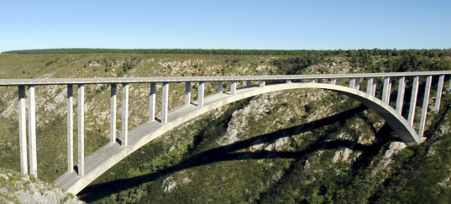
This is NOT in a Text Book
Engineering
Zoology
Document cataloguing
Military combat planning
Methods of structured software design
Strategic planning techniques
etc
Dozens of pulse measurements – what does NOT work and what does
Cataloguing and analysing findings
Trial and error
Never did process BUT produced excellent results
Then a client told me I was incompetent because I did not do process ☺
Proven conclusively process close to irrelevant for ERP implementation
Process is at BEST an output

Slide 4
The fundamental requirements for an ERP
The answers to questions I have not yet thought to ask
Enable me to run the business MY way
Accurately model every aspect of my business
Totally integrated solution
Entirely reliable and dependable
Fundamentally support the essence of the business and how it thrives (strategy)
Fully support my day to day operational functions
The subject of this presentation is a way in which these requirements can be met in the financial arena

Slide 5
Unlocking the TRUE potential of ERP
vs The Factors Driving Mediocrity
DO NOT know it is possible
Inappropriate Governance
Operational investment focus
No concept of how to deliver strategic advantage
Lack of a holistic Integrated Business Information Systems (IBIS) view
Unaware of the CRITICAL role of the strategic solution architect
The commercial model of implementation is diametrically opposed to a high value outcome
The average rate approach
Process and "as is" obsession
Technobabble
Sloppy configuration
Confusion regarding valid customization
Lack of awareness of the benefits of strategic customization
Sloppy CONTRACTS with no accountability
Unconscious incompetence is EVERYWHERE

Slide 6
Engineers design bridges NOT to fall down
Notes:
There is a fundamental difference in approach when one designs a bridge NOT TO FALL DOWN
Contrast this with the IT paradigm which could be called “designed to fail”

Slide 7
Factors causing ERP failure
Strictly confidential – privileged information

Slide 8
The value of technology is determined by the person using the technology
Notes:
A gun is neither good nor bad
If it is held by a person you regard as good and pointed at a person you regard as bad the gun is good
BUT if it is pointed at YOU it is always BAD!

Slide 9
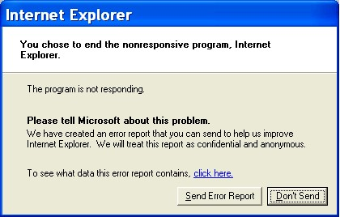
Technology is only 5% of what causes failure
Software defects CAN be prevented
Take a stand
Notes:
A gun is neither good nor bad
If it is held by a person you regard as good and pointed at a person you regard as bad the gun is good
BUT if it is pointed at YOU it is always BAD!

Slide 10
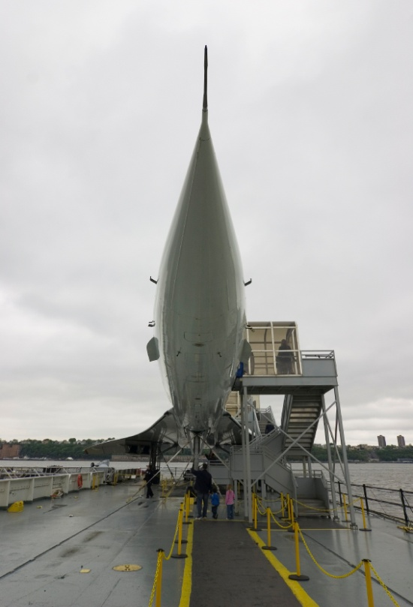
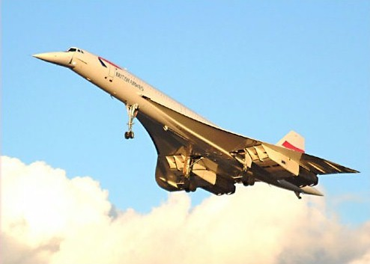
Is IT moving so fast you cannot keep up?
Notes:
You CAN keep up with technology
Make technology slow down to the pace that suits your business
Relevant technology that works
GESTURES
Do you remember the Concorde? – Johannesburg to London in three hours? – BUT the people on the ground were not prepared to tolerate the BOOMMMMMMMMMMM as the plane travelled at supersonic speed so it never took off commercially, only 20 were built and one crashed owing to a design flaw and the last planes today are sitting in museums
Then there was the Boeing 747 – designed almost by accident – tell the story
So, is IT moving so fast – not really – the big question is whether Windows Vista is the Concorde of IT

Slide 11
Three alternative ERP value scenarios Unlocking the TRUE potential of ERP / IBIS 100 / 1,000 x the norm ???
1,000
XXX 10
This is the ONLY valid scenario but it seldom occurs
3. Strategic customization
With CEO Custody
Relative strategic value measured in terms of business competitiveness, growth and profitability
2. Strategic precision configuration with CEO Executive Custody
1. Current industry norm for process based “Best Practice”
X 1
100
10
X 0.01
0
0
0

Slide 12
What is a computer?
A person
Notes:
DHL, Prochem,

Slide 13
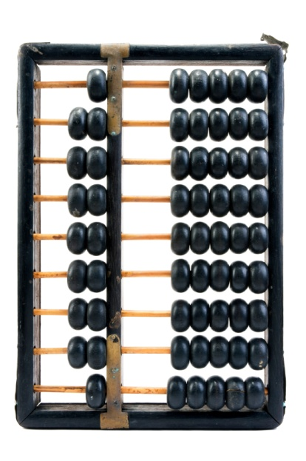
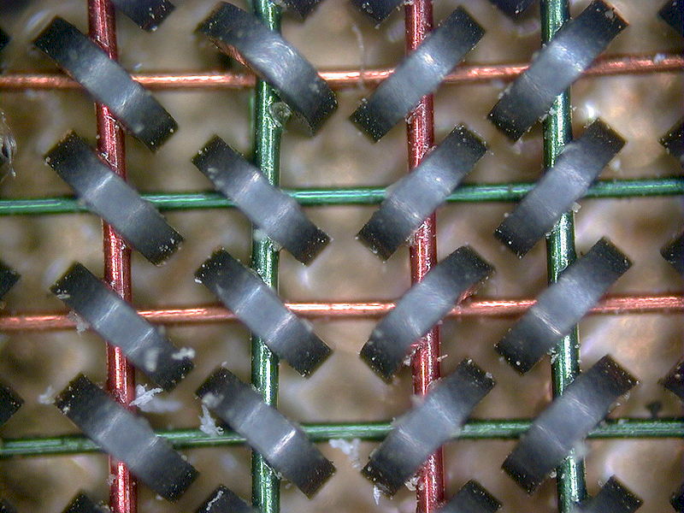
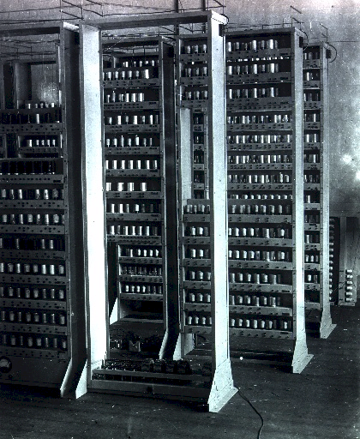
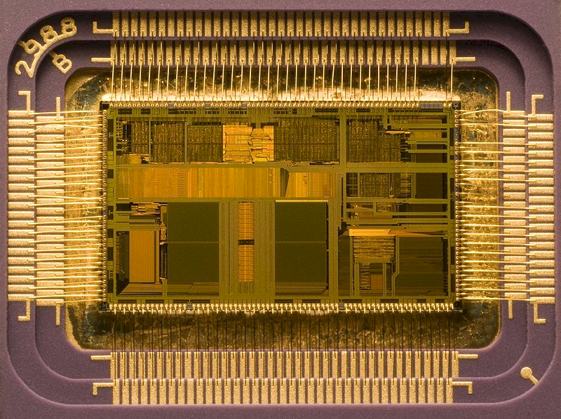
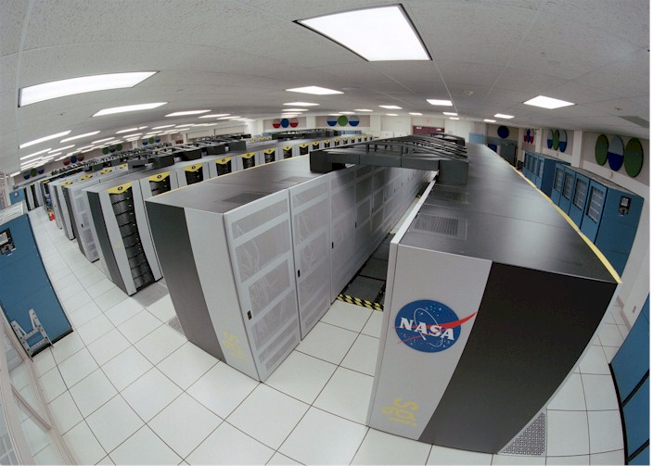
What is a computer?
Adding machine / calculator
0
1
1+1=10
1+1+1=11
1+1+1+1=100
Called a “bit”
8 bits make a byte
2 bytes make an ASCII character
A=41 hex
Notes:
DHL, Prochem,

Slide 14
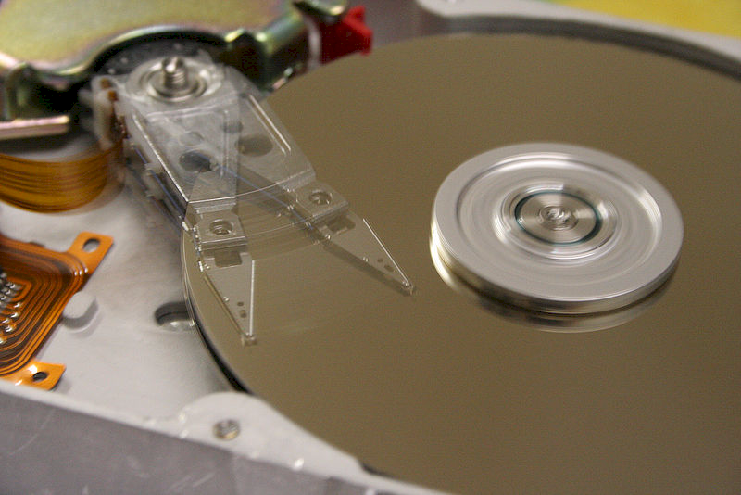
What is a computer?
Memory and disk
00110101010101101010101010101010101011100010101010000000111111100101010101010101010101010101010101010101010110......... x billions of counts
Notes:
DHL, Prochem,

Slide 15
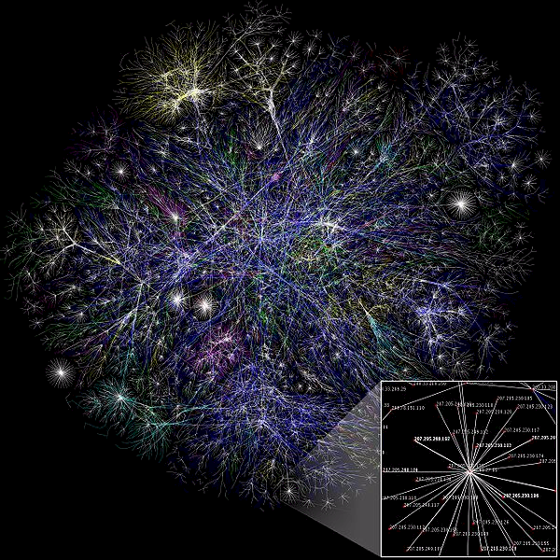
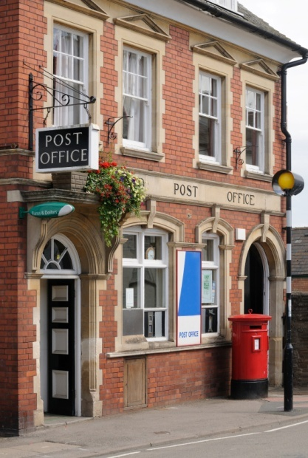
What is a computer?
Communications / postal service
“to .... 00110101010101101010101010101010101011100010101
10000011111110010101010101010101010101010101010101010
1010110......... x from ...”
Notes:
DHL, Prochem,

Slide 16
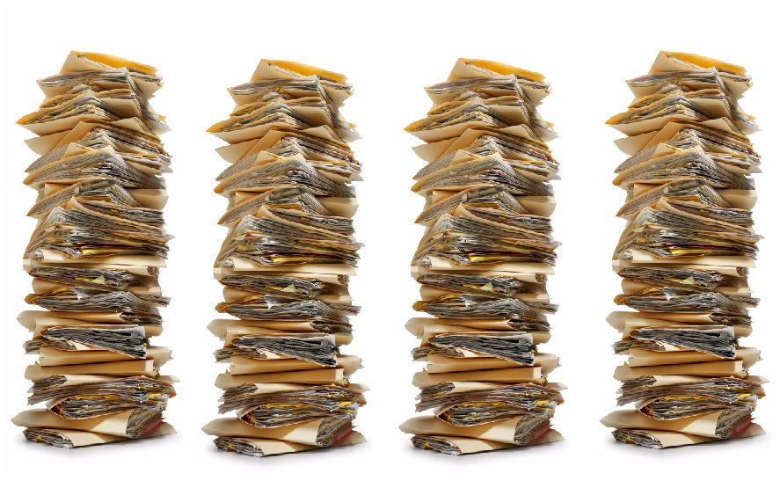
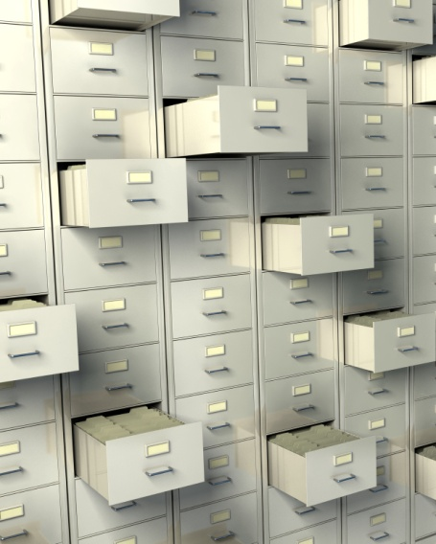
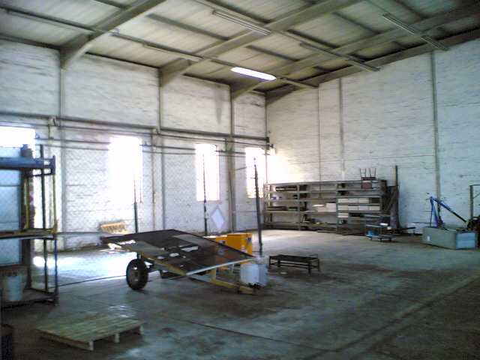
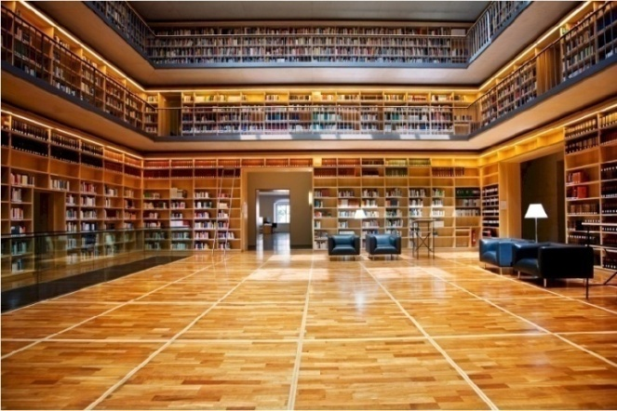
What is a computer?
Databases
“00110101010101101010101010101010101011100010101
10000011111110010101010101010101010101010101010101010
1010110......... ”
Filing cabinet
Warehouse
File
etc
Notes:
DHL, Prochem,

Slide 17
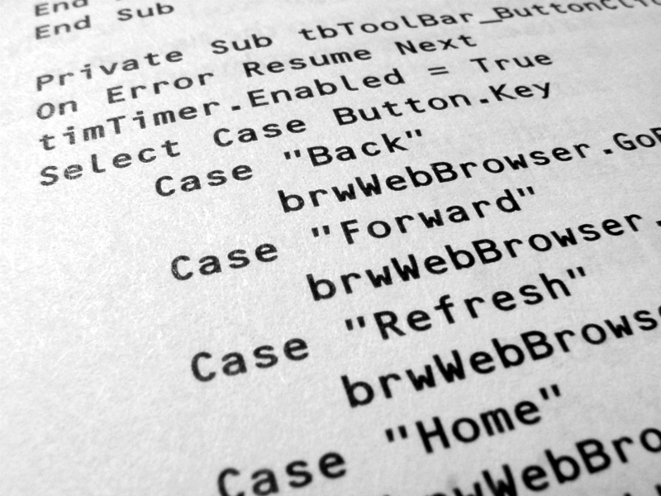
What is a computer?
Software – source code
“to .... 00110101010101101010101010101010101011100010101
10000011111110010101010101010101010101010101010101010
1010110......... x from ...”
Notes:
DHL, Prochem,

Slide 18
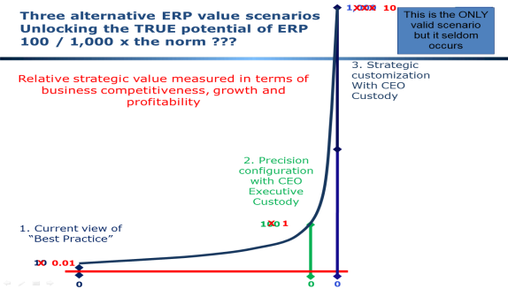
IBIS – what every company REALLY has ☺
Data warehouse and BI
Spreadsheets
Brandname ERP = FRED
Industry specific package
Etc, etc, etc
Custom-ization
In-house custom development

Slide 19
What is a computer?
Software – human output view
Notes:
DHL, Prochem,

Slide 20
What is a computer?
Software – source code
Notes:
DHL, Prochem,

Slide 21
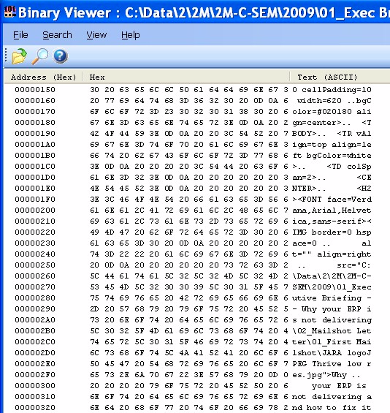
What is a computer?
Software – hexadecimal
Notes:
DHL, Prochem,

Slide 22
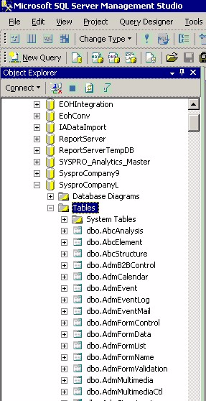
What is an ERP?
Tables
Notes:
DHL, Prochem,

Slide 23
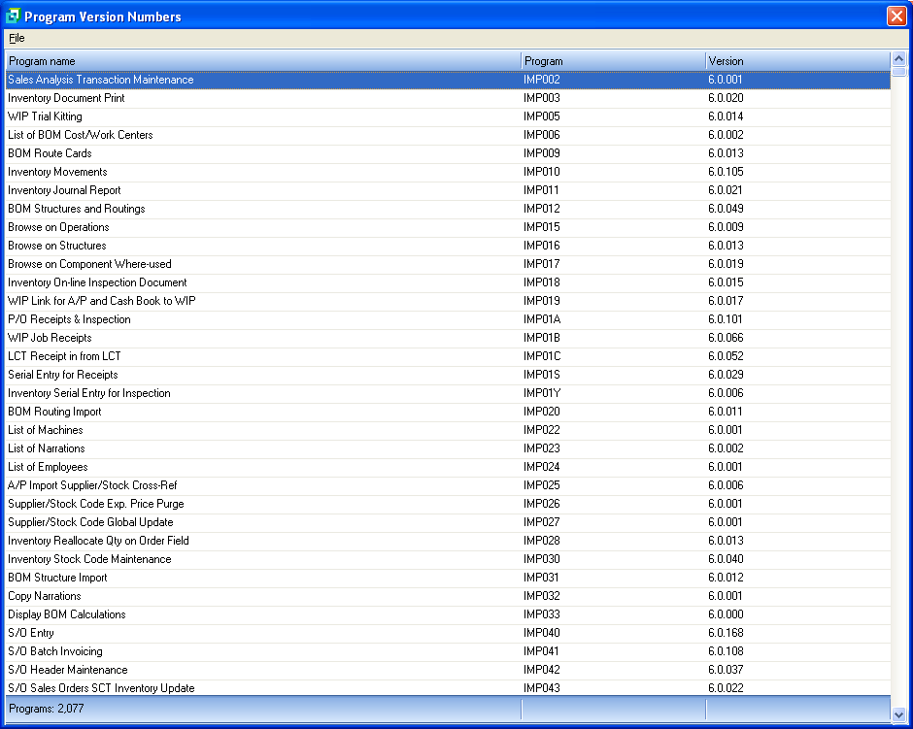
What is an ERP?
Executable programs
Notes:
DHL, Prochem,

Slide 24
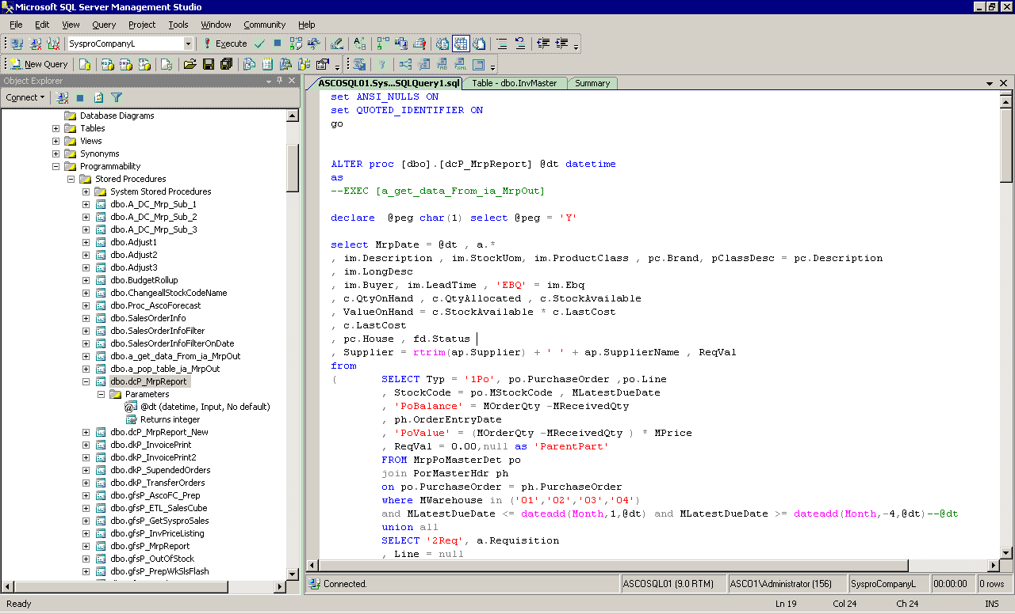
What is an ERP?
Examples
Notes:
DHL, Prochem,

Slide 25
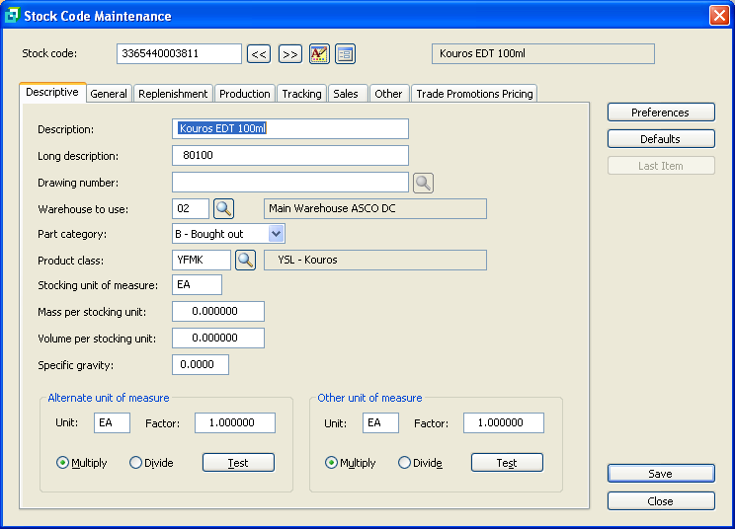
What is an ERP?
Examples
Notes:
DHL, Prochem,

Slide 26
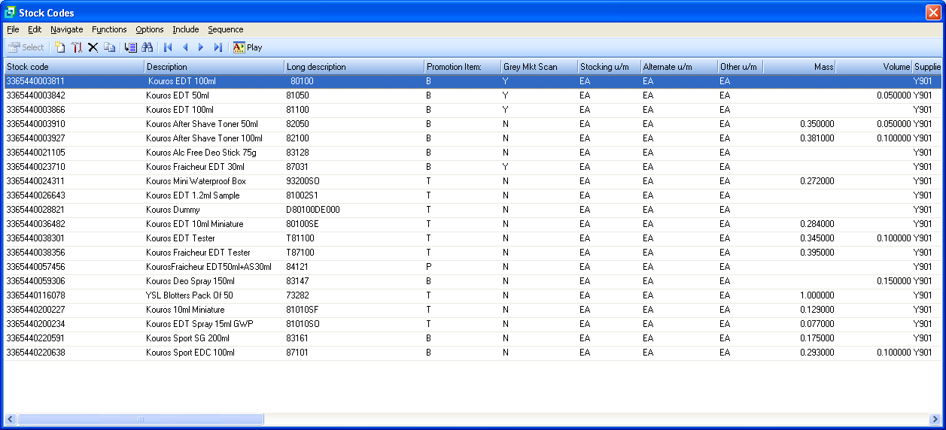
What is an ERP?
Examples
Notes:
DHL, Prochem,

Slide 27
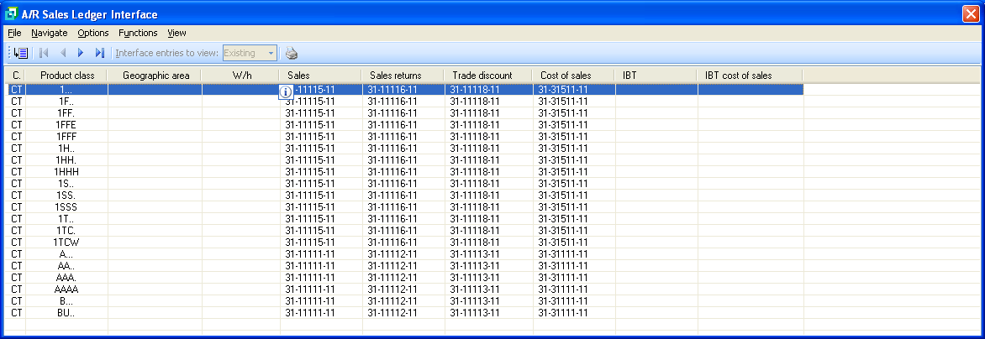
What is an ERP?
Examples
Notes:
DHL, Prochem,

Slide 28
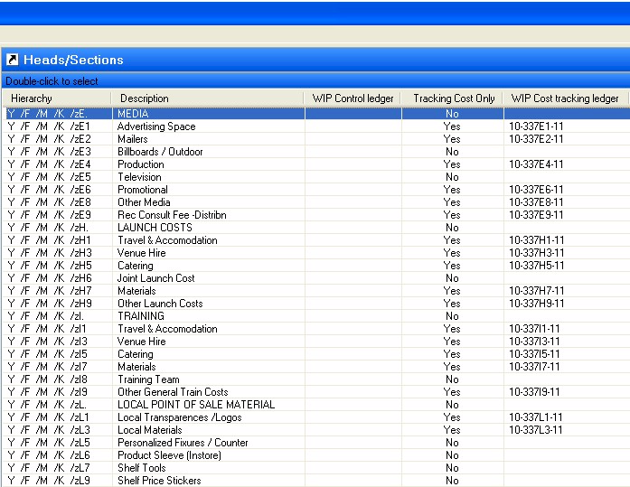
What is an ERP?
Example -- the @#$%^&*XX^#%
system has LOST my data!!!
Notes:
DHL, Prochem,

Slide 29
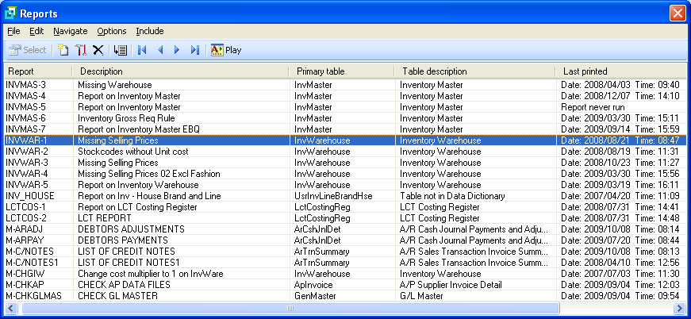
What is an ERP?
Reports
Notes:
DHL, Prochem,

Slide 30
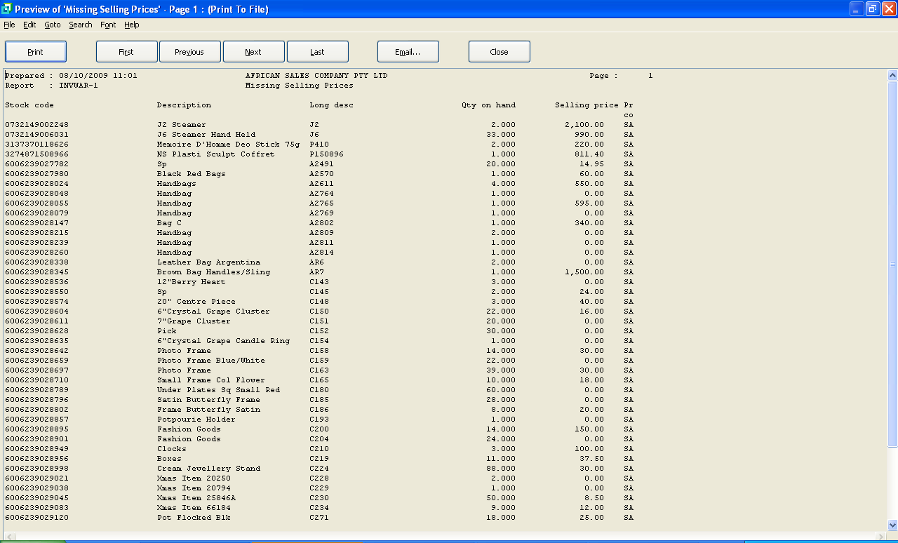
What is an ERP?
Examples
Notes:
DHL, Prochem,

Slide 31
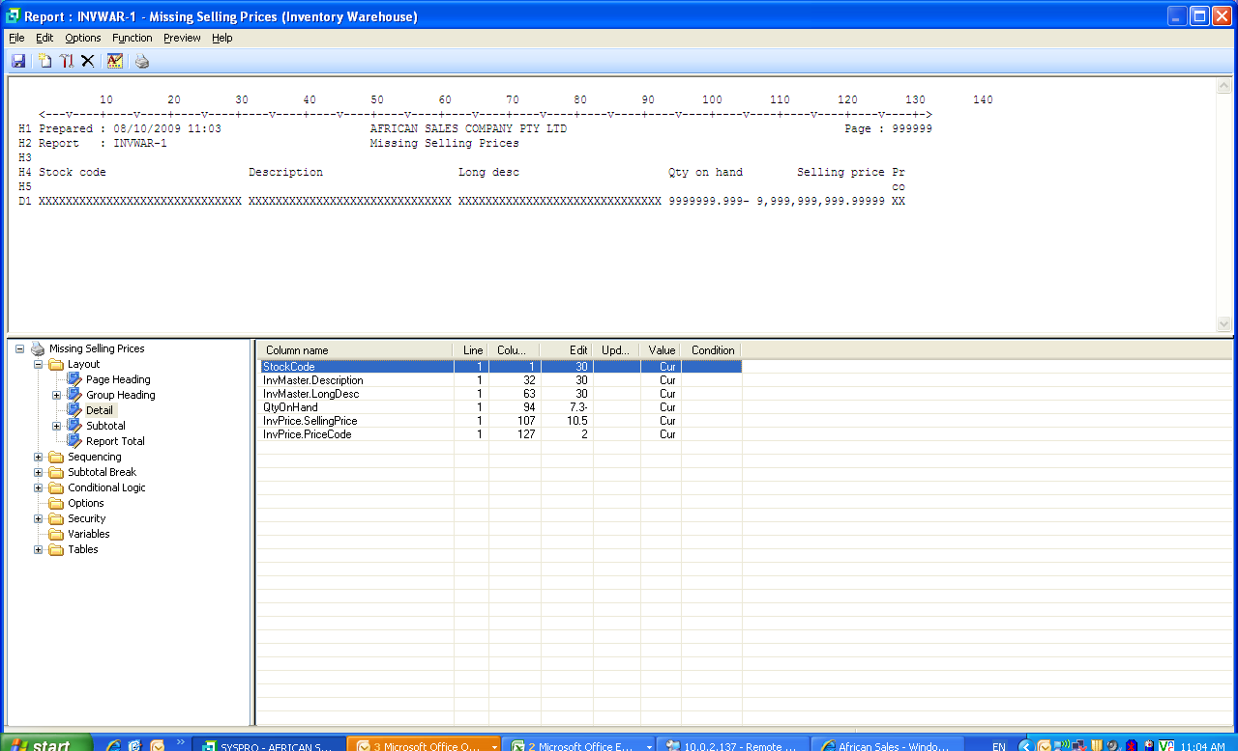
What is an ERP?
Reports
Notes:
DHL, Prochem,

Slide 32
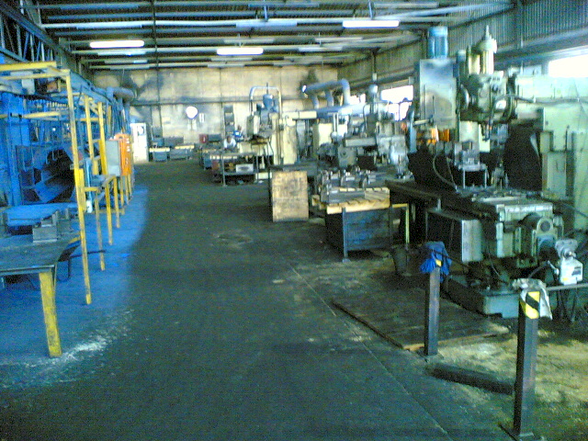
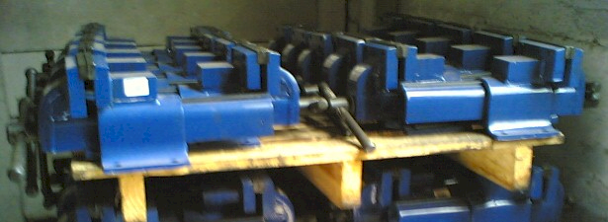
What is an ERP?
REALLY?
Notes:
DHL, Prochem,

Slide 33
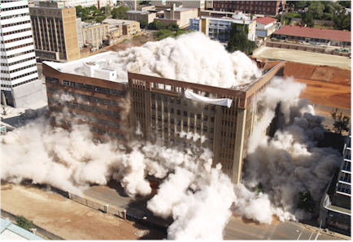
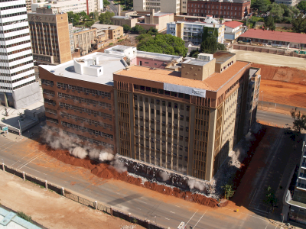
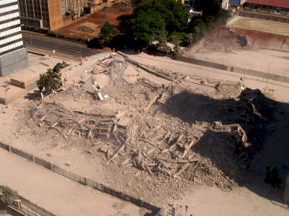
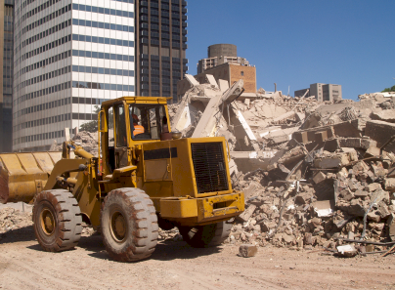
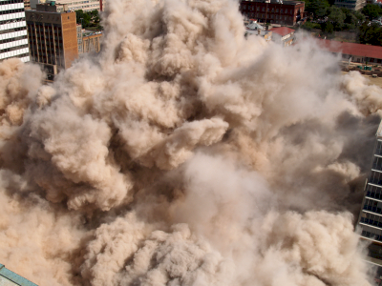
vs Deleting a building
Notes:
DHL, Prochem,

Slide 34
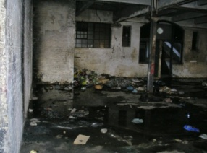
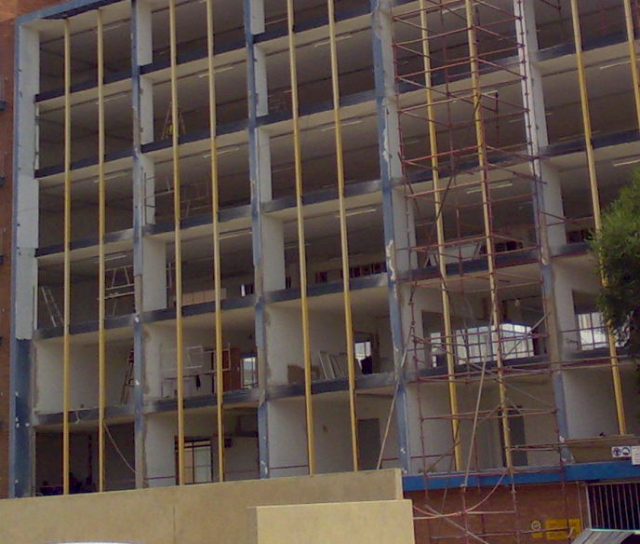
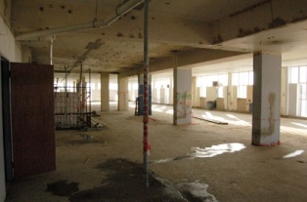
What is an ERP?
Refurbish
Notes:
DHL, Prochem,

Slide 35
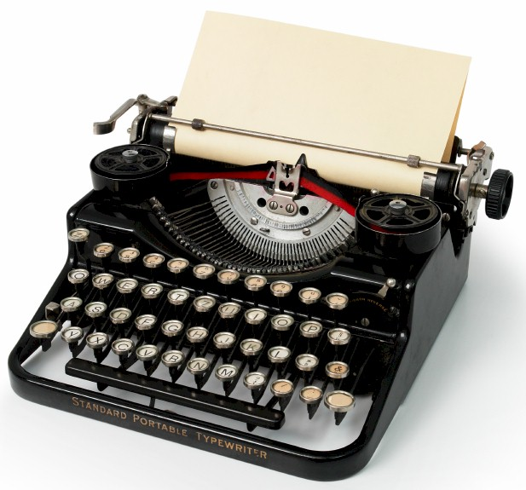
What is IT?
REALLY?
The MOST important skill?
Notes:
You understand the technology well enough to manage it
VERSUS ABDICATION / DISEMPOWERMENT
FAST
Computers are simply adding machines or switches that switch left or right – 0 or 1 – on or off – called binary – they just do things very quickly, everything you see is a pattern of 0’s and 1’s – a very fast Abacus – the content is always the same – binary code -- source code is simply instructions for the bricklayer
Wordprocessors are typewriters -- The typing story – so why do you want to spend thousands of Rands upgrading your typewriter every few years? -- Databases are filing cabinets or warehouses -- General ledgers are large books that book keepers write in – networks are postal systems – large frame pictures cost a lot and take up lots of space

Slide 36
What is an ERP?
General ledger
?
Notes:
You understand the technology well enough to manage it
VERSUS ABDICATION / DISEMPOWERMENT
FAST
Computers are simply adding machines or switches that switch left or right – 0 or 1 – on or off – called binary – they just do things very quickly, everything you see is a pattern of 0’s and 1’s – a very fast Abacus – the content is always the same – binary code -- source code is simply instructions for the bricklayer
Wordprocessors are typewriters -- The typing story – so why do you want to spend thousands of Rands upgrading your typewriter every few years? -- Databases are filing cabinets or warehouses -- General ledgers are large books that book keepers write in – networks are postal systems – large frame pictures cost a lot and take up lots of space

Slide 37
What is an ERP?
REALLY?
"Attendees of Gartner's Business Intelligence Summit in London last month were not surprised to hear that most enterprises are still failing to use business intelligence (BI) strategically. Gartner's survey of over 1300 CIOs returned some unimpressive findings about the state of BI implementations: Gartner's vice: president of research summed up the situation nicely by saying: "Most organisations are not making better decisions than they did five years go."

Slide 38
Questions?
Dr James Robertson PrEng
James A Robertson & Associates
Telephone: ++27-(0)86-111-5409 / ++27-11- 782-5996/7
Cell: 083-251-6644 (preferred)
Fax: ++27-(0)86-540-0178
P O Box 4206, Randburg, 2125, South Africa
www.JamesARobertson.com
email: James@JamesARobertson.com
Please remember to complete the evaluation forms
Finding the missing pieces of your I.T. and strategy puzzles

